Slide 1
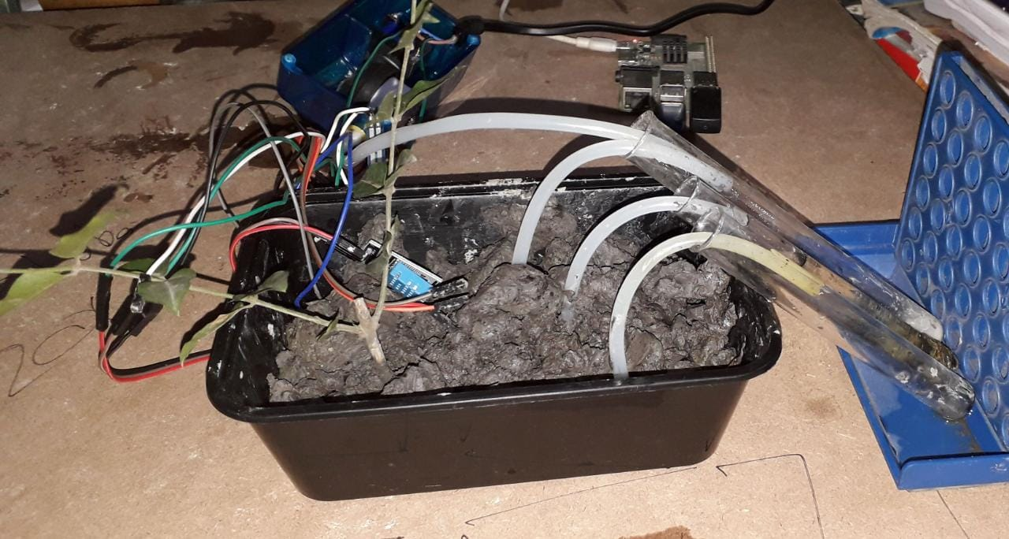
Outreach Plan:

Slide 2
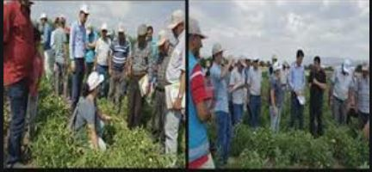
In General Scope:
Can be implemented anywhere
Private krishi vikas is now corporate
Lots of Kisan are looking for employment so we can reach every class of farmer(classified on basis on annual income)

